Slide 1
Introduction to Microsoft Azure IoT with Windows 10 IoT Core
Code Labs

Slide 2
Bee Hive Slides
The following slides with the hex diagram in them are very fast. Treat them as a continuous slide set / build.
Talking points are in notes.
The slides are available online; attendees don’t need time to view every detail live.

Slide 4





Azure IoT Suite
Open Ecosystem
The Internet of Your Things
Hyper-scale
Hybrid &
On-Prem
Secure
Connectivity &
Management
Move Beyond Building Blocks with
Pre-Configured Solutions
Rich Dashboards and Visualizations
Azure IoT Suite
Business Workflow Integration
Secure Device Connectivity & Management
Enterprise
Proven
Data Analytics &
Ecosystem
Data Ingestion and Command & Control
End To End
Security & Privacy
Stream Processing & Predictive Analytics
Notes:
“Microsoft Azure IoT Suite brings together everything needed for IoT in the cloud, and works with the devices you have to build a complete IoT solution.”

Slide 5
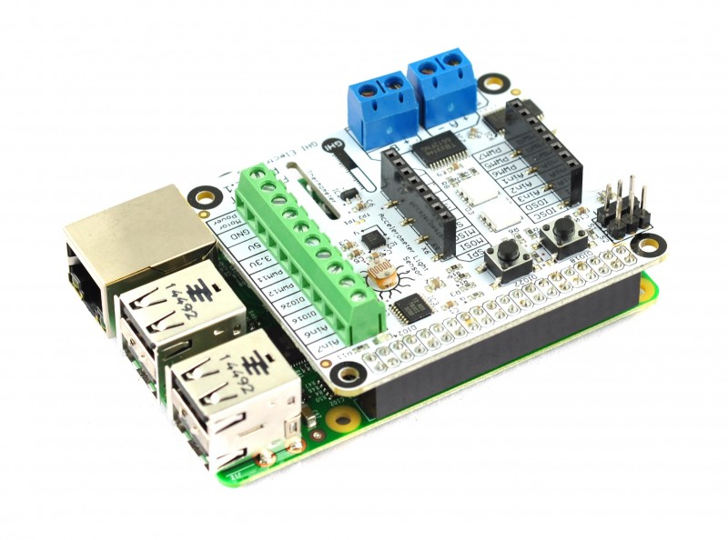
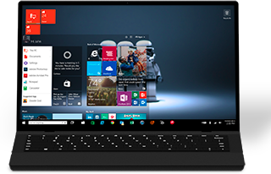
Lab Setup
Direct wired Ethernet for Deploy/Debug
WiFi for Azure
Development PC
Raspberry Pi 3 with FEZ HAT
Notes:
“At each of your stations is a Raspberry Pi 3, hard-wired to the development PC. This is for deployment and debugging. The WiFi connection from the Pi 3 is for connection to Azure. The FEZ HAT contains the sensors we’ll use to collect data.”

Slide 6
IoT Lab modules
1
Learn about Windows 10 IoT Core on the Raspberry Pi 3
2
Learn about Microsoft Azure IoT without using any device
(concurrent with module 3)
3
Learn how to connect Windows 10 IoT Core with Microsoft Azure
(concurrent with module 2)
4
Concurrent Open Hack
(days 2 and 3)
Notes:
“If you are interested in the underlying IO and other capabilities on devices like the Raspberry Pi, or want to explore more with Azure and devices, we also have the Open Hack in this same room, starting on Day 2.”

Slide 7
IoT Dev Code Lab Related Sessions Wednesday 03/30
11:30 – 12:30 |  | IoT Lab Module 1 Here | Windows 10 IoT Core and Azure IoT Suite QSC Garage
14:00 – 15:00 |  | IoT Lab Modules 2 + 3 Here | Windows 10 IoT Core and Azure IoT Suite QSC Garage
15:30 – 16:30 | IoT: Microsoft’s IoT Vision and Roadmap Marriott 7 | IoT Lab Module 1 Here | Windows 10 IoT Core and Azure IoT Suite QSC Garage
17:00 – 18:00 |  | IoT Lab Modules 2 + 3 Here | Windows 10 IoT Core and Azure IoT Suite QSC Garage

Slide 8
IoT Dev Code Lab Related Sessions Thursday 03/31
11:30 – 12:30 |  | IoT Module 1 Open Hack! Here | Windows 10 IoT Core and Azure IoT Suite QSC Garage
14:00 – 15:00 |  | IoT Lab Modules 2 + 3 Open Hack! Here | Windows 10 IoT Core and Azure IoT Suite QSC Garage
15:30 – 16:30 | Azure IoT: Product, Vision & Roadmap Marriott 8 | IoT Module 1 Open Hack! Here | Windows 10 IoT Core and Azure IoT Suite QSC Garage
17:00 – 18:00 |  | IoT Lab Modules 2 + 3 Open Hack! Here | Windows 10 IoT Core and Azure IoT Suite QSC Garage
18:30 – 19:30 | Developer’s Guide to Connecting Devices to Azure IoT Marriott 8 | IoT Module 1 Open Hack! Here | Windows 10 IoT Core and Azure IoT Suite QSC Garage

Slide 9
IoT Dev Code Lab Related Sessions Friday 04/01
09:00 – 10:00 | Windows 10 IoT Core: From Maker to Market Marriott 7 | IoT Module 1 Open Hack! Here | Windows 10 IoT Core and Azure IoT Suite QSC Garage
10:30 – 11:30 |  | IoT Lab Modules 2 + 3 Open Hack! Here | Windows 10 IoT Core and Azure IoT Suite QSC Garage
12:30 – 13:30 |  | IoT Module 1 Open Hack! Here | Windows 10 IoT Core and Azure IoT Suite QSC Garage
14:00 – 15:00 |  | IoT Lab Modules 2 + 3 Open Hack! Here | Windows 10 IoT Core and Azure IoT Suite QSC Garage

Slide 10
Lab
Share your photos and experiences!
#Build2016

Slide 11
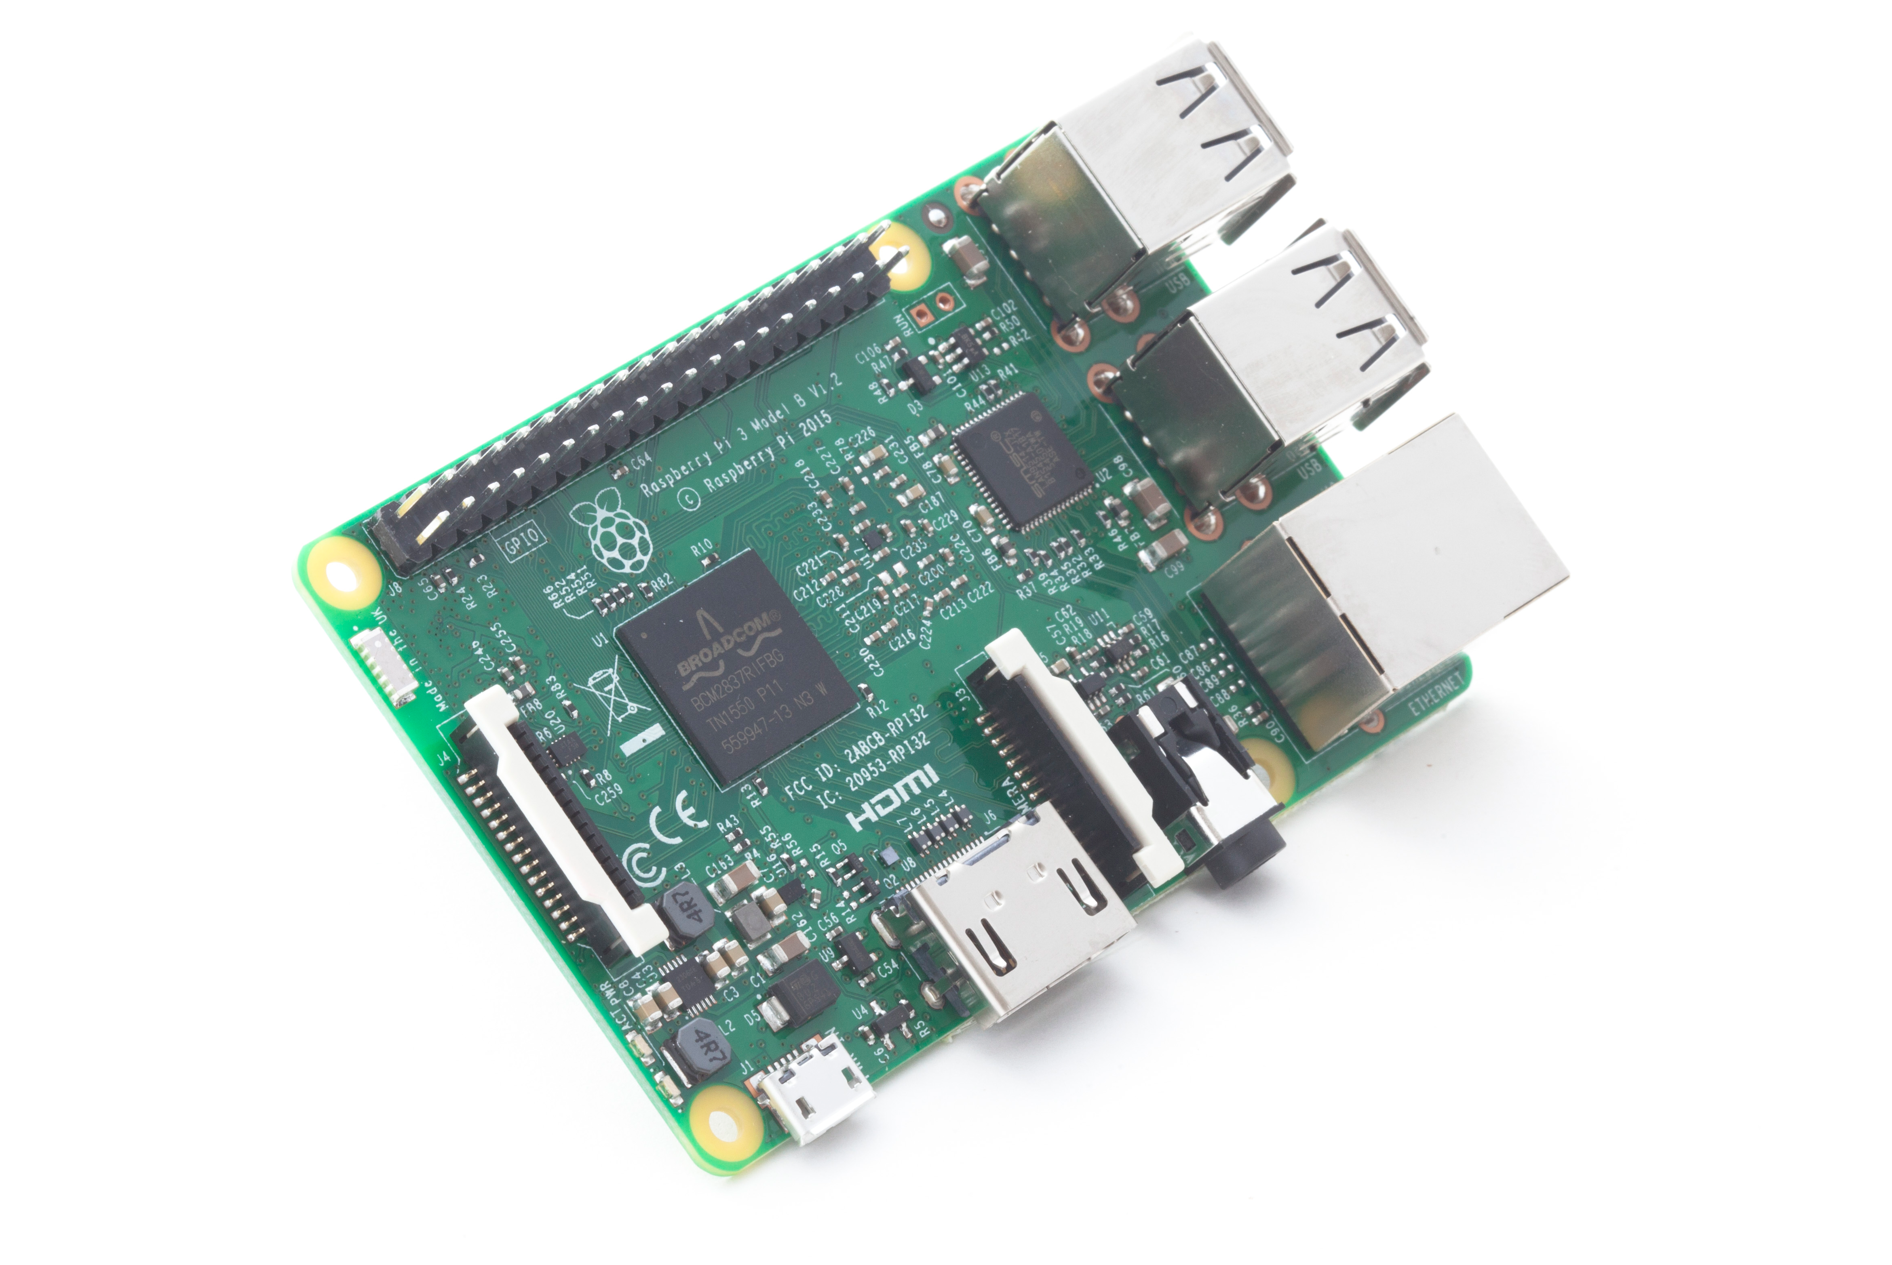
Checkpoint 1
Logged into Azure Portal
Any problems setting up the IoT Hub?
Notes:
20 minutes into the session
If it looks like more than a few people are having problems, do a deploy from the podium. Anyone interested can watch

Slide 12
Checkpoint 2
Receiving data from the device (or app)?
View the data on the portal?
Maybe you have the website up and running?
Notes:
40 minutes into the session (half hour after the presentation ends)

Slide 13
Wrap-Up
Please clean up around your workstation
Return all additional components and materials to the table.
Unless you are staying through to the next session, please log out of the PC
Come back for open hack on days 2 + 3!
Notes:
End of session
“Thanks everyone! I hope you were able to make it through all of the exercises. If not, feel free to hang around for a bit to keep working during the break. You’re also welcome to come back again and repeat the lab.
If you really want to tinker and experiment, come back to the Open Hack. Space permitting, this runs during all sessions on days 2 and 3.”

